Slide 1

HTML Review
Ranken Technical College

Slide 2
Objectives
Review HTML Document Structure
Review <head> section tags
Review <body> section tags
Introduction to HTML Forms

Slide 3
Hypertext Markup Language (HTML)
HTML is used to define
the structure of web pages.
Source
https://developer.mozilla.org/en-US/docs/Glossary/HTML
Notes:
https://developer.mozilla.org/en-US/docs/Glossary/HTML

Slide 4
HTML Documents
Anotomy of an HTML Document

Slide 5
HTML Document Structure
<!DOCTYPE html>
<html lang="en">
<head>
<meta>
<title>
<link>
</head>
<body>
<!-- Content -->
</body>
</html>

Slide 6
<!DOCTYPE html>
The required <!DOCTYPE html> preamble is found at the top of HTML documents.
Its sole purpose is to prevent the browser from switching into so-called "quirks mode" when rendering a document.
Source
https://developer.mozilla.org/en-US/docs/Glossary/Doctype
Notes:
https://developer.mozilla.org/en-US/docs/Glossary/Doctype

Slide 7
<html lang="en">...</html>
The <html> tag represents the root of an HTML document.
Note: You should always include the lang attribute inside the <html> tag, to declare the language of the Web page. This is meant to assist search engines and browsers.
Source
https://developer.mozilla.org/en-US/docs/Web/HTML/Element/html
https://www.w3schools.com/Tags/tag_html.asp
Notes:
https://developer.mozilla.org/en-US/docs/Web/HTML/Element/html
https://www.w3schools.com/Tags/tag_html.asp

Slide 8
<head>...</head>
The HTML <head> element contains machine-readable information (or metadata) about the document, like its title, scripts, and style sheets.
Source
https://developer.mozilla.org/en-US/docs/Web/HTML/Element/head
Notes:
https://developer.mozilla.org/en-US/docs/Web/HTML/Element/head

Slide 9
<meta />
The HTML <meta> element defines metadata about an HTML document.
Metadata is data about data.
Metadata is used by browsers, search engines, and other web services.
<meta> tags always go inside the <head> element.
Examples
<meta charset="utf-8">
<meta name="description" content="This will often show up in search results.">
<meta name="viewport" content="width=device-width, initial-scale=1">
Source
https://developer.mozilla.org/en-US/docs/Web/HTML/Element/meta
Notes:
https://developer.mozilla.org/en-US/docs/Web/HTML/Element/meta

Slide 10
<title>...</title>
The HTML <title> element defines the document's title that is shown in a browser's title bar or tab.
It only contains text. Tags within the element are ignored
<title> tags always go inside the <head> element.
Example
<title>Home Page - Ranken Technical College</title>
Source
https://developer.mozilla.org/en-US/docs/Web/HTML/Element/title
Notes:
https://developer.mozilla.org/en-US/docs/Web/HTML/Element/title

Slide 11
<link />
The HTML External Resource Link element <link> specifies relationships between the current document and an external resource.
<link> is most commonly used to link to CSS stylesheets.
<link> tags always go inside the <head> element.
Example
<link rel="stylesheet" type="text/css" href="/css/main.css" >
Source
https://developer.mozilla.org/en-US/docs/Web/HTML/Element/link
Notes:
https://developer.mozilla.org/en-US/docs/Web/HTML/Element/link

Slide 12
Content
Common tags used in the body of an HTML document.

Slide 13
HTML5 Tags for sectioning content
<header>
<nav>
<main>
<section>
<article>
<aside>
<footer>
etc.
<header>
<nav>
<main> | <aside>
<footer>
Source
https://developer.mozilla.org/en-US/docs/Web/HTML/Element#Content_sectioning
Notes:
https://developer.mozilla.org/en-US/docs/Web/HTML/Element#Content_sectioning

Slide 14
<div>...</div>
The HTML <div> element is the generic block-level element.
Source
https://developer.mozilla.org/en-US/docs/Web/HTML/Element/div
Notes:
https://developer.mozilla.org/en-US/docs/Web/HTML/Element/div

Slide 15
<span>...</span>
The HTML <span> element is the generic inline-level element.
Source
https://developer.mozilla.org/en-US/docs/Web/HTML/Element/span
Notes:
https://developer.mozilla.org/en-US/docs/Web/HTML/Element/span

Slide 16
Block-Level Elements
By default, a block-level element occupies the entire width of its parent element (container), thereby creating a "block".
Browsers typically display the block-level element with a newline both before and after the element.
e.g.: <div>, <h1>, <h2>, <p>, <ol>, <ul>, <li>
Source
https://developer.mozilla.org/en-US/docs/Web/HTML/Block-level_elements
Notes:
https://developer.mozilla.org/en-US/docs/Web/HTML/Block-level_elements

Slide 17
Inline-Level Elements
Inline elements are those which only occupy the space bounded by the tags defining the element, instead of breaking the flow of the content.
An inline element does not start on a new line and only takes up as much width as necessary.
e.g.: <span>, <strong>, <em>, <a>, <img>
Source
https://developer.mozilla.org/en-US/docs/Web/HTML/Inline_elements
Notes:
https://developer.mozilla.org/en-US/docs/Web/HTML/Inline_elements

Slide 18
Headings <h1>-<h6>
The HTML <h1>-<h6> elements represent six levels of section headings.
<h1> is the highest section level.
<h6> is the lowest section level.
Heading information may be used by a variety of user agents, for example, to construct a table of contents for a document automatically.
Avoid using heading tags to resize text. Instead, use the CSS font-size property. Headings use size to indicate their relative importance, but CSS is preferred for general-purpose resizing.
Source
https://developer.mozilla.org/en-US/docs/Web/HTML/Element/Heading_Elements
Notes:
https://developer.mozilla.org/en-US/docs/Web/HTML/Element/Heading_Elements

Slide 19
Paragraph <p>…</p>
The HTML <p> element represents a paragraph of text.
The <p> element has top/bottom margin by default. (browser-dependent)
The <p> element is a block-level element.
The <p> element cannot contain block-level elements.
Do not use it as a generic container! Use <div> instead.
Source
https://developer.mozilla.org/en-US/docs/Web/HTML/Element/p
Notes:
https://developer.mozilla.org/en-US/docs/Web/HTML/Element/p

Slide 20
Ordered List <ol>…</ol>
The HTML <ol> element represents an ordered list of items – typically rendered as a numbered list
<ol> Renders as:
<li>An Element</li> 1. An Element
<li>Another Element</li> 2. Another Element
</ol>
Source
https://developer.mozilla.org/en-US/docs/Web/HTML/Element/ol
Notes:
https://developer.mozilla.org/en-US/docs/Web/HTML/Element/ol

Slide 21
Unordered List <ul>…</ul>
The HTML <ul> element represents an unordered list of items – typically rendered as a bulleted list
<ul> Renders as:
<li>An Element</li> • An element
<li>Another Element</li> • Another element
</ul>
Source
https://developer.mozilla.org/en-US/docs/Web/HTML/Element/ul
Notes:
https://developer.mozilla.org/en-US/docs/Web/HTML/Element/ul

Slide 22
HTML Forms
An abbreviated review of the HTML form tags.

Slide 23
Forms
<form action="contact_me.html" method="POST/GET">…</form>
The HTML <form> element represents a document section containing interactive controls for submitting information.
The action attribute is the URL that processes the form submission.
The method attribute specifies how the form data will be submitted. Usually GET (via query string) or POST (via request body).
Source
https://developer.mozilla.org/en-US/docs/Web/HTML/Element/form
Notes:
https://developer.mozilla.org/en-US/docs/Web/HTML/Element/form

Slide 24
Common Form Tags
<input> Interactive form controls to accept a single piece of user data.
<select> Form control that provides a menu of options.
<textarea> Multi-line plain-text editing control.
<button> Clickable (programmable) button
<fieldset> Groups controls and labels within a form.
<legend> Caption for a corresponding fieldset.

Slide 25
Example Form
<form action="simple_form.html" method="POST">
<fieldset>
<legend>Simple Form</legend>
<input name="email" type="email" placeholder="Email Here">
<select name="favpet">
<option value="">--Favorite Pet--</option>
<option value="dog">Dog</option>
<option value="cat">Cat</option>
<option value="bird">Bird</option>
</select>
<button type="submit">Submit</button>
</fieldset>
</form>

Slide 26
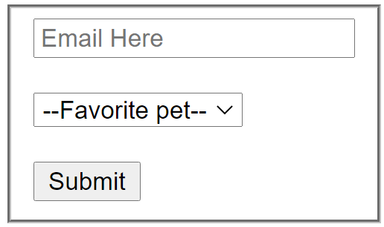
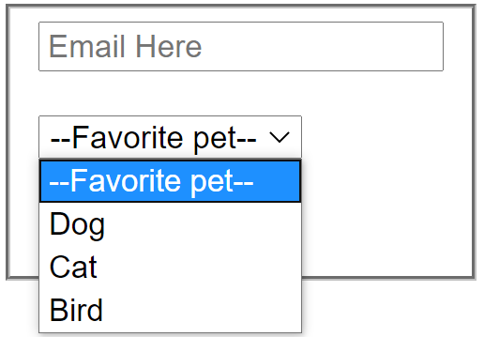
Example Form

Slide 27
Conclusion
What did we learn today?

Slide 28
What We Covered
Review HTML Document Structure
Review <head> section tags
Review <body> section tags
Introduction to HTML Forms

Slide 29
Some Useful URLs
https://developer.mozilla.org/en-US/docs/Glossary/HTML
https://developer.mozilla.org/en-US/docs/Learn/HTML
https://developer.mozilla.org/en-US/docs/Learn/HTML/Howto
https://developer.mozilla.org/en-US/docs/Learn/Getting_started_with_the_web

